Slide 1
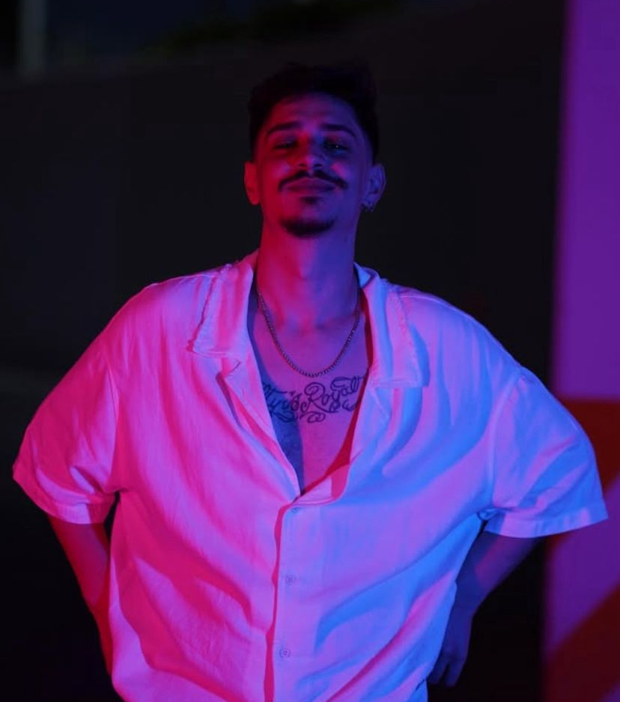
01
BURAK
TOKAT
DJ • ELECTRONIC MUSIC PRODUCER
MELODIC TECHNO / MELODIC HOUSE / AFRO HOUSE
ELECTRONIC PRESS KIT • 2026
Notes:
[Sources]
- Official artist photograph and identity: https://buraktokat.github.io/
[/Sources]

Slide 2

02
ARTIST PROFILE
Emotion-led electronic music with a club-focused pulse.
Burak Tokat is a Turkish DJ and electronic music producer based in Antalya. Active since 2020, his sound moves between Melodic Techno, Melodic House and Afro House—combining hypnotic rhythm, emotional melody and contemporary club production.
SIGNATURE
HYPNOTIC RHYTHM EMOTIONAL MELODY CLUB ENERGY Antalya • Türkiye
His artistic signature is built on movement and atmosphere: music designed for the dancefloor, shaped to leave an emotional trace.
Notes:
[Sources]
- Artist biography and official positioning: https://buraktokat.github.io/
[/Sources]

Slide 3
03
SELECTED EXPERIENCE
Verified club experience built across Konya and Bursa.
SINCE 2020
CLUB INFERNO MANIA
MR. FROG
Active DJ and electronic music producer
Konya branch Bursa branch Club experience
Konya Selected past club experience
Notes:
[Sources]
- Selected experience supplied by the artist and published on the official website: https://buraktokat.github.io/#experience
[/Sources]

Slide 4
04
SELECTED MUSIC
Current releases defining Burak Tokat’s musical direction.
FEELS LIKE
CRESCENT
Original Mix Melodic House & Techno Surrealismo Records Released 1 February 2024 Available on Spotify and Beatport
Upcoming Single Melodic Techno Colorica Pre-order 23 October 2026 Release 6 November 2026 A personal, emotion-led record
Notes:
[Sources]
- Release details and official platform links: https://buraktokat.github.io/#music
[/Sources]

Slide 5
05
BOOKING & CONTACT
Club • Festival • Private Event • Press
BURAK TOKAT
DJ • ELECTRONIC MUSIC PRODUCER
Instagram — @burak_tkt
Website — buraktokat.github.io
Booking — buraktokatmr@gmail.com
Official profiles — Spotify • Apple Music • YouTube
ELECTRONIC PRESS KIT • 2026
Notes:
[Sources]
- Official contact and profiles: https://buraktokat.github.io/#booking
[/Sources]

